Slide 1
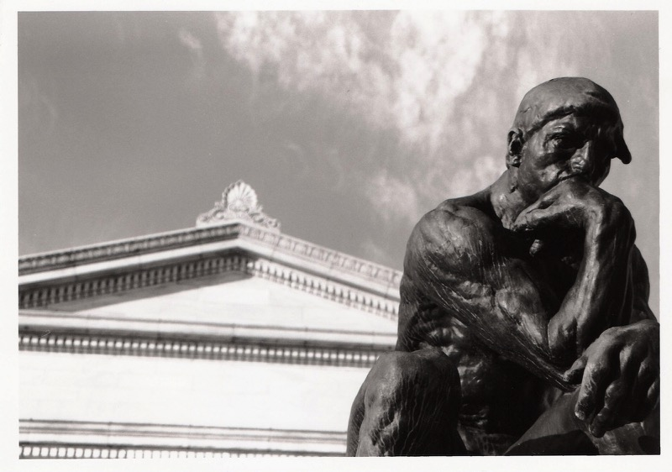
How to Be a Wise Guy
1 Corinthians 2:6-16
Dr. Rick Griffith • Crossroads International Church Singapore
cicfamily.com & BibleStudyDownloads.org

Slide 2
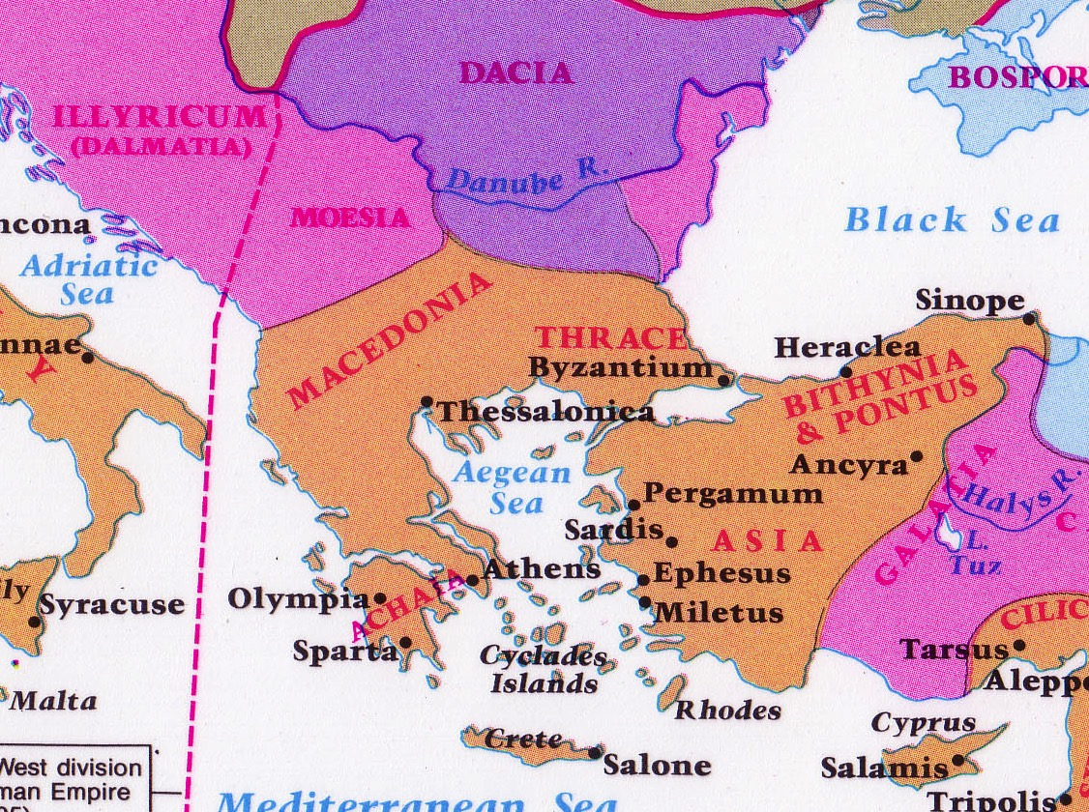
Philosophies at Athens
Athens
Corinth

Slide 3
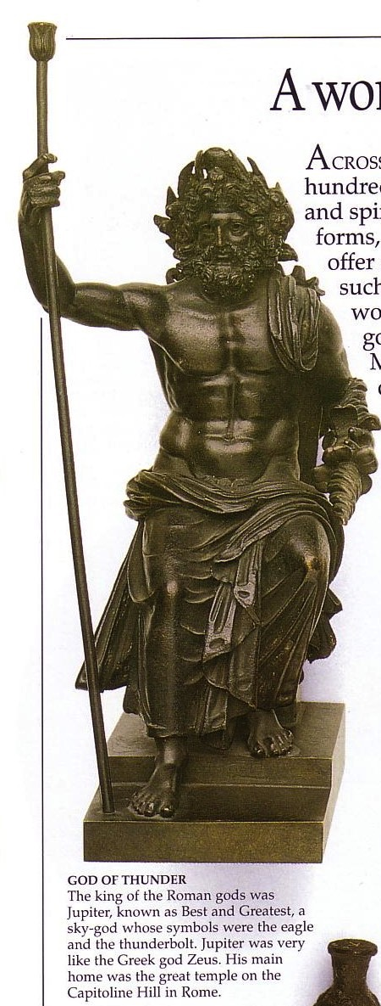
Greek Schools of Philosophy

Slide 4
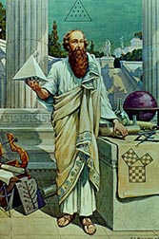

Pythagoras
Pythagorean Theorem
Basic math to design many structures
a² + b² = c²
c
a
b

Slide 5

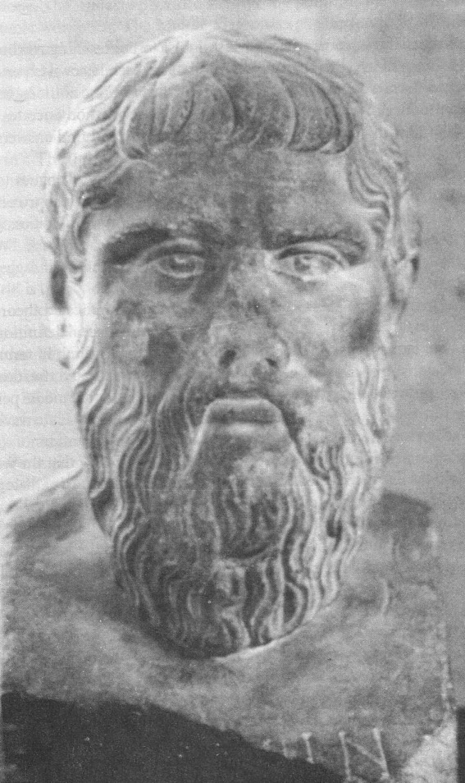


Plato
151
429-380 BC
Socratic method
Reality is in mental ideas

Slide 6
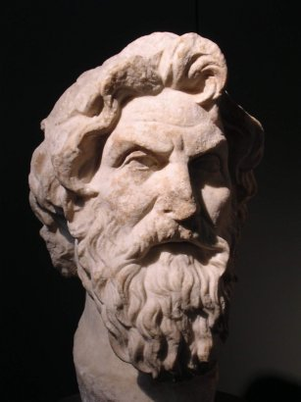
Cynics: Antisthenes
151
"Antisthenes of Athens (c. 445-c. 360 BC) is regarded as the founder of Cynicism. He was a student of Gorgias, but later he became a pupil and follower of Socrates. He usually expressed his distain for conventional values and pleasure. For Antisthenes, desire leads to pleasure and pleasure to the misery of insufficient and temporal happiness. For Antisthenes only virtue is sufficient for real happiness, that is well-being."
www.philosophy.gr/hellinistic/cynics.htm
Notes:
Antisthenes of Athens (c.445-c.360 BC) is regarded as the founder of Cynicism. He was a student of Gorgias, but later he became a pupil and follower of Socrates. He usually expressed his distain for conventional values and pleasure. For Antisthenes, desire leads to pleasure and pleasure to the misery of insufficient and temporal happiness. For Antisthenes only virtue is sufficient for real happiness, that is well-being. A virtuous person is sufficient with whatever is present and with future expectations and social conventions. According to Diogenes Laertius (Lives and Opinions of Eminent Philosophers VI ):
And the doctrines he adopted were these. He used to insist that virtue was a thing which might be taught; also, that the nobly born and virtuously disposed, were the same people; for that virtue was of itself sufficient for happiness. And was in need of nothing, except the strength of Socrates. He also looked upon virtue as a species of work, not wanting many arguments, or much instruction; and he taught that the wise man was sufficient for himself; for that everything that belonged to any one else belonged to him. He considered obscurity of fame a good thing, and equally good with labour. And he used to say that the wise man would regulate his conduct as a citizen, not according to the established laws of the state, but according to the law of virtue.
Translated by Yonge {http://www.philosophy.gr/hellinistic/cynics.htm}

Slide 7
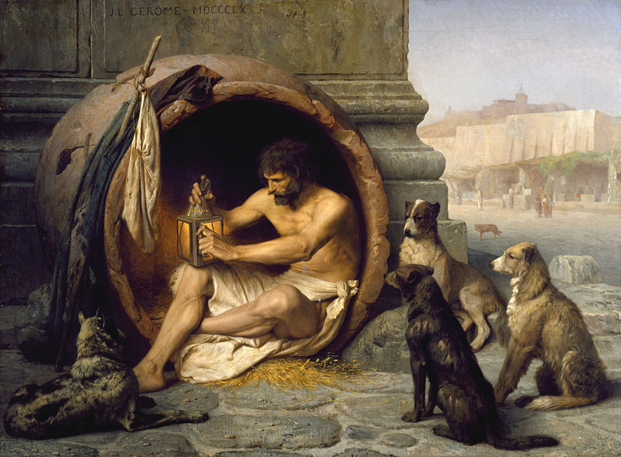
Cynics: Diogenes of Sinope
151
Notes:
Diogenes lived in a barrel (some say a bathtub) publicly, begging from people and giving wise sayings to those who came to see him.

Slide 8
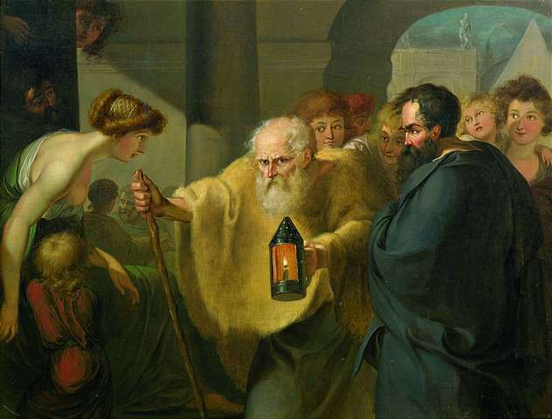
Cynics: Diogenes of Sinope
151
Notes:
Diogenes regularly took a lamp publicly to say he was looking for an honest man.

Slide 9
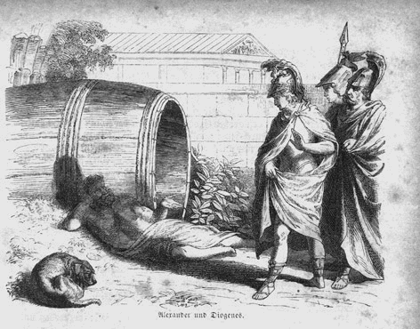
Cynics: Diogenes of Sinope
151
Notes:
Diogenes of Sinope (c.400-c.325 BC) was a follower of Antisthenes and probably the most popular of the Cynics. Plato called Diogenes 'Socrates gone mad'. He had an extreme personality with strong views. He denied pleasure and physical wealth for asceticism. He had the nickname 'the dog' because of his shamelessness. He used to live in a barrel with only two possessions: a robe to wear and a stick to walk. There are many stories for Diogenes' rebellious and anti-conformal character. According to some ancient sources Diogenes carried a lighted lamp in broad daylight looking in the streets of Athens for the honest man. But the most famous anecdote of his life is related to Alexander the Great. When Alexander stood before him and asked him if he had any desire, Diogenes asked Alexander to move a little to one side because he was blocking the sun.
There lived a wise man in ancient Greece whose name was Diogenes. Men came from all parts of the land to see him and talk to him.
Diogenes was a strange man. He said that no man needed much, and so he did not live in a house but slept in a barrel, which he rolled about from place to place. He spent his days sitting in the sun and saying wise things to those who were around him.
When Alexander the Great came to that town he went to see the wise man. He found Diogenes outside the town lying on the ground by his barrel. He was enjoying the sun.
When he saw the king he sat up and looked at Alexander. Alexander greeted him and said:
"Diogenes, I have heard a great deal about you. Is there anything I can do for you?"
"Yes," said Diogenes, "you can step aside a little so as not to keep the sunshine from me."
The king was very much surprised. But this answer did not make him angry. He turned to his officers with the following words:
"Say what you like, but if I were not Alexander, I should like to be Diogenes."
[Retrieved from http://www.de.dau.lv/angluvaloda/ang1/node21.html]

Slide 10
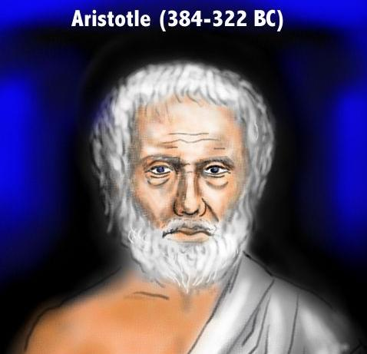
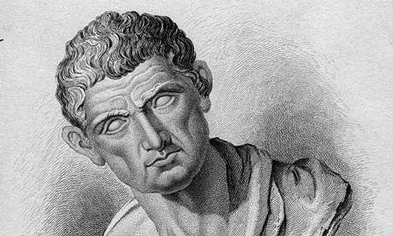
Aristotelianism
151
Reality is the material world (what you can see and touch)

Slide 11
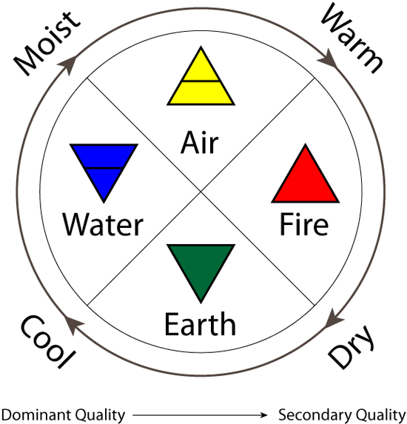
Aristotle's 4 Elements
Reality = Material World

Slide 12
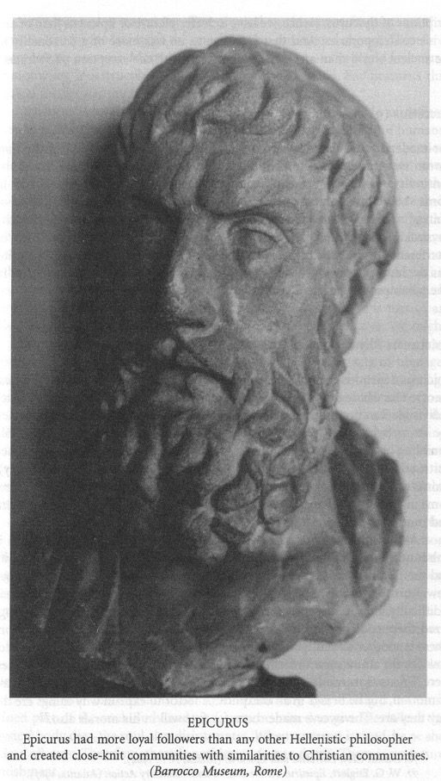
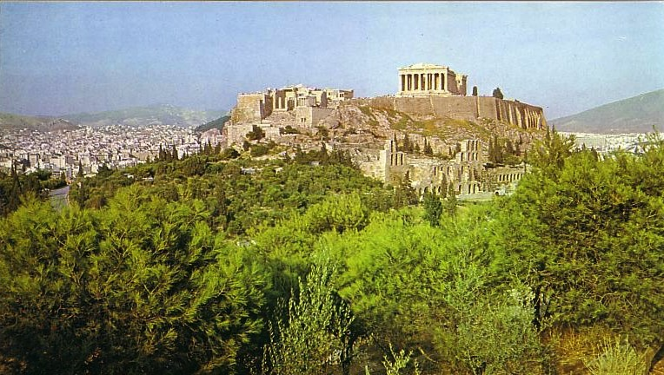
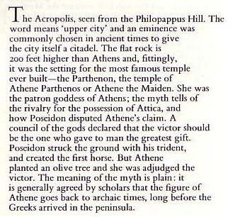
Epicureans and Stoics at the Parthenon
151

Slide 13
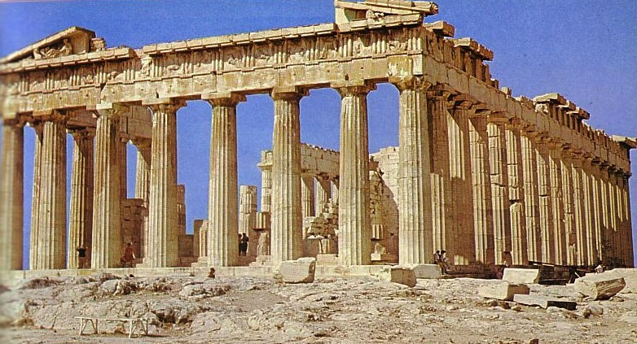
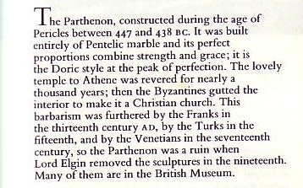
The Parthenon: Place of Debate
151

Slide 14

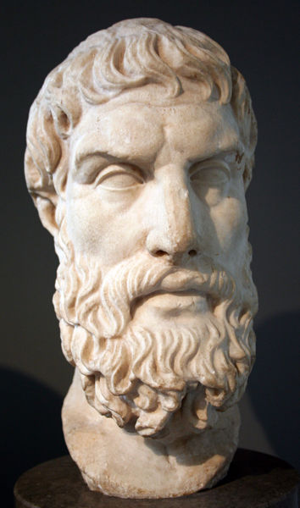
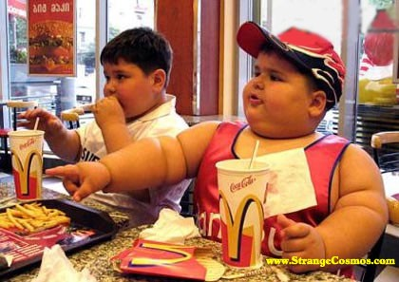

Epicureanism
151

Slide 15
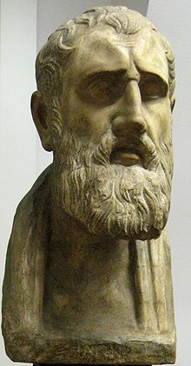
Stoicism
151
Rejected Epicureanism
"Reality is natural reason"
Cause & effect
Led to materialism
Zeno of Citium (336-264 BC)
Notes:
"The Stoics taught that destructive emotions resulted from errors in judgment, and that a sage, or person of 'moral and intellectual perfection,' would not suffer such emotions ("Stoicism," Stanford Encyclopedia of Philosophy cited at http://en.wikipedia.org/wiki/Stoicism; accessed 15 Sept 2012).

Slide 16
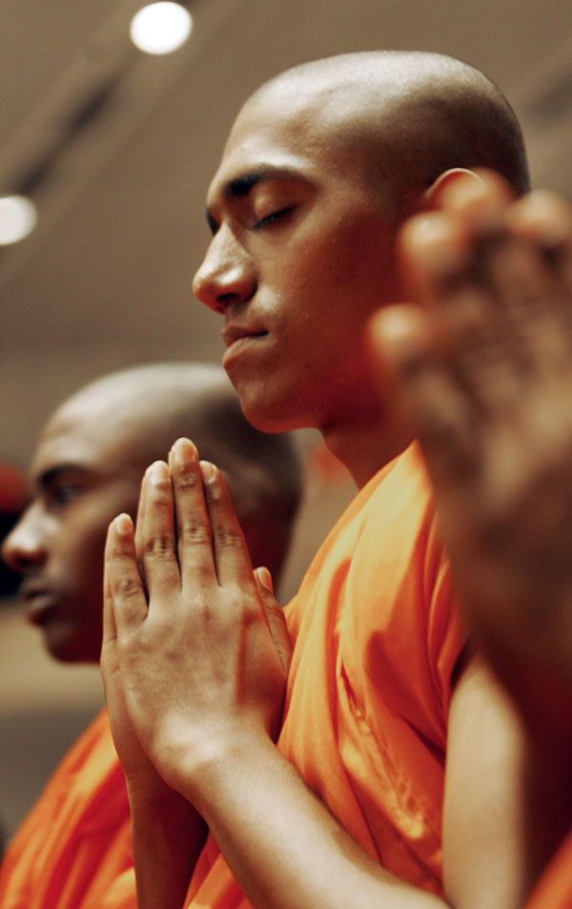
Stoicism Today
151
"Stoicism in the West, like Buddhism in the East, was a philosophy that sought not only to explain the nature of the physical world and our knowledge of it; but also to provide guidance on how to live the best life, and how to confront the challenges we all face in living."
gettingstronger.org/stoicism
Notes:
"Stoicism in the West, like Buddhism in the East, was a philosophy that sought not only to explain the nature of the physical world and our knowledge of it; but also to provide guidance on how to live the best life, and how to confront the challenges we all face in living" cited at http://gettingstronger.org/stoicism/; accessed 15 Sept 2012).

Slide 17
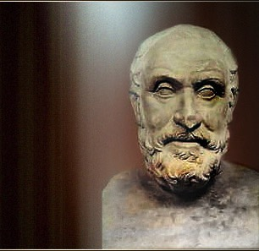
Skepticism: Pyrro of Elis
151
• Knowledge is unattainable
• Just "go with the flow"

Slide 18


Eclectics
151
"I'm a Buddhist.
I'm a Muslim.
I'm a Christian.
I'm whatever you want me to be.
It all comes down to the same thing."
Actor Jim Carrey
60 Minutes, 21 Nov 04

Slide 19
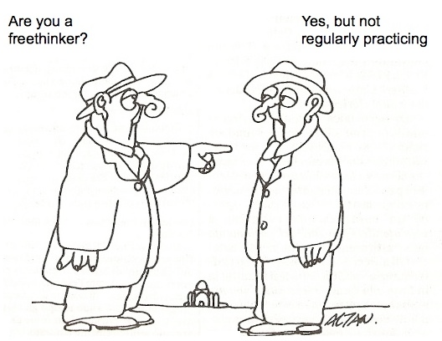
Eclectics Today = Freethinkers
Are you a freethinker?
Yes, but not
regularly practicing.

Slide 20
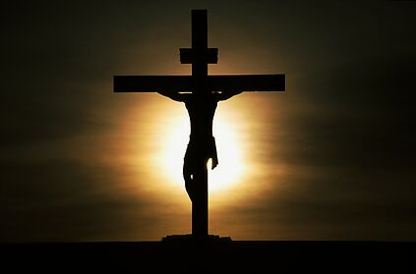
The Challenge of Greek Philosophy Against Christianity
151
Platoism
Pythogoreanism
Cynicism
Eclectics
Aristotelianism
Skepticism
Epicurianism
Stoicism

Slide 21

Are you wise?

Slide 22
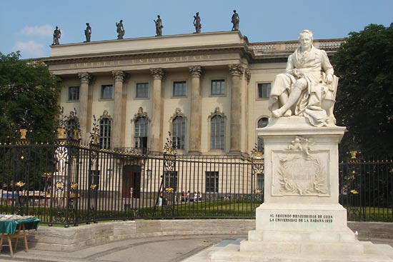
Finding an address…

Slide 23
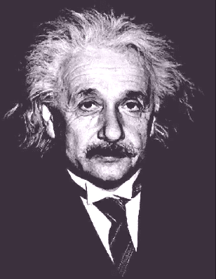
Albert Einstein (1879-1955)

Slide 24
How is your…
IQ?
(Intelligence Quotient)
WQ?
(Wisdom Quotient)

Slide 25

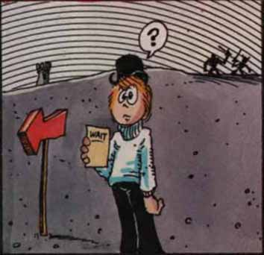
The Path to Unity: Focus on…
… things going right
(1:1-9)
… God's wisdom
(2:6-16)
… Christ crucified
(1:10–2:5)

Slide 26

The path to unity is to focus on God's wisdom
Today's Main Idea:
But how?

Slide 27

I. The gospel is God's secret message of wisdom that the world rejects (2:6-10).

Slide 28
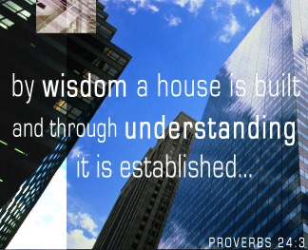
A. Believers do speak wisdom--God's wisdom
(2:6)

Slide 29
A. Believers do speak wisdom––God's wisdom (2:6 NLT)
6 Yet when I am among mature Christians, I do speak with words of wisdom, but not the kind of wisdom that belongs to this world, and not the kind that appeals to the rulers of this world, who are being brought to nothing.

Slide 30
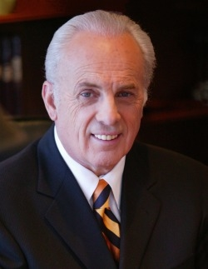
John MacArthur, Jr.

Slide 31
John MacArthur, "The Foolishness of God" sermon on 1 Cor. 1:18-21, Part 1, #GC 1813
"Human wisdom never solves anything. All of our education never solves anything. You say, 'Wait a minute! Wait a minute! We used to be living in the boondocks out there in the bush, and now we're in cities and homes.' That's right, and we're just as rotten here as we were there. We haven't changed. We're just more comfortable. [Now] our immorality isn't committed out in the wood, it's committed in fancy hotels. It isn't any different. We just make our sinning a little more accommodated."

Slide 32
John MacArthur, "The Foolishness of God" sermon on 1 Cor. 1:21-28, Part 2, #GC 1814
"The problem with man's wisdom is that it's nice to sit around and talk about it, but it can't do anything. Have you ever noticed that? People don't get changed lives from it, it doesn't transform people, it doesn't forgive sin, it doesn't make new creatures, it doesn't usher people into the presence of God, it doesn't do anything like that. It gives people satisfaction by playing little intellectual games, and builds their ego by telling people what they know."

Slide 33
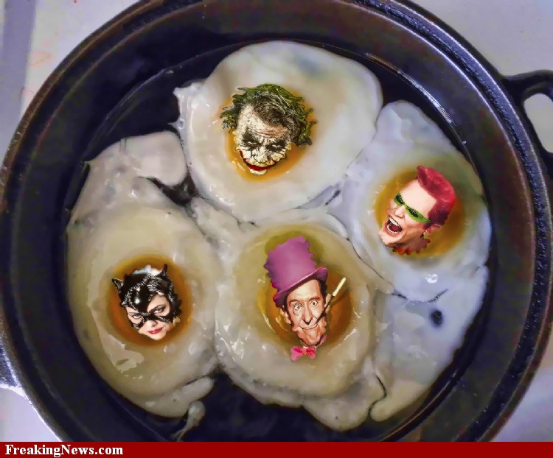
C. S. Lewis
"No clever arrangement of bad eggs will make a good omelet"
–– C. S. Lewis

Slide 34
Black

Slide 35

MENSA
Subtitle

Slide 36

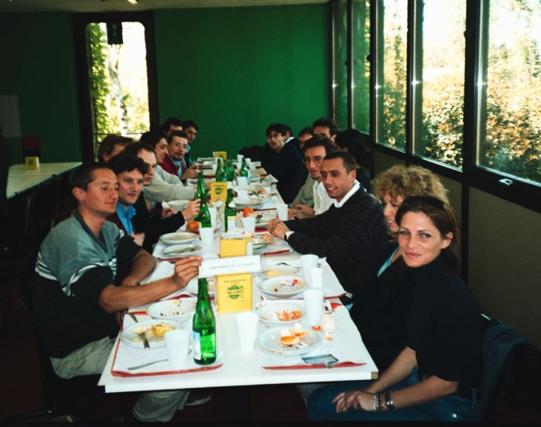
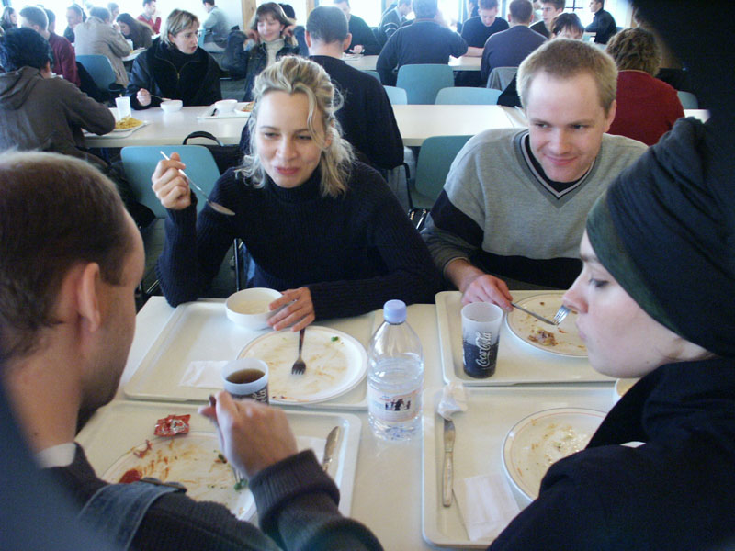
MENSA

Slide 37


Types of Wisdom
God's
vs.
Man's
Salvation is God's free gift
"There is no such thing as a free lunch"

Slide 38
Types of Wisdom
God's
vs.
Man's
God became man
God cannot become man

Slide 39
B.C. by Johnny Hart
It seems to me that since the fall—
without even thinking it odd—
that man has had no trouble at all
believing that he can be God.
How he could do this I cannot conceive,
Tho, he certainly thinks that he can—
And yet, he cannot bring himself to believe,
that God can become a man.

Slide 40
Types of Wisdom
God's
vs.
Man's
You cannot visualize things into reality
"Just Imagine!"

Slide 41
Types of Wisdom
God's
vs.
Man's
Explosions create chaos
––not order
"Big Bang!"

Slide 42
Types of Wisdom
God's
vs.
Man's
Sex outside of marriage hurts everyone
"Casual Sex"

Slide 43
Types of Wisdom
God's
vs.
Man's
Character is our most vital asset
Education is our most vital asset

Slide 44

POPCLUB

Slide 45

POPCLUB

Slide 46
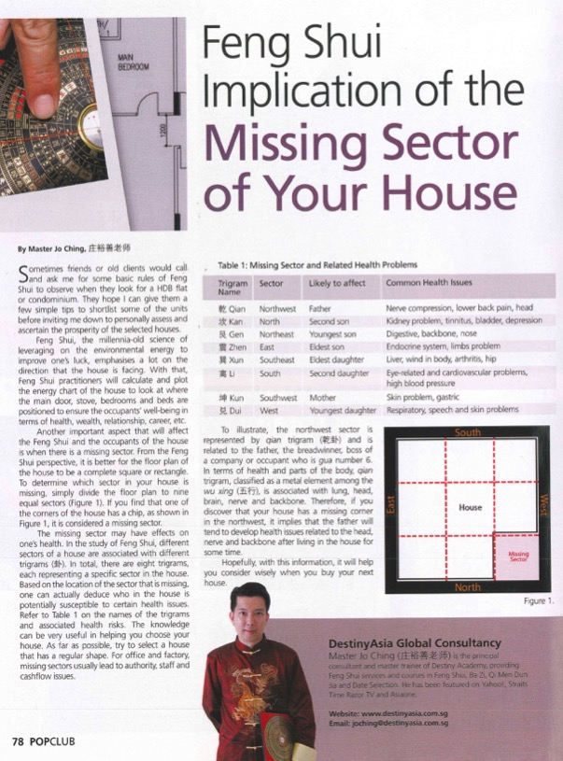

POPCLUB

Slide 47

B. Only believers understand
God's wisdom (7-10)
"but we speak God's wisdom in a mystery…" (2:7 NASB)
• secret (7a)

Slide 48

Top Secret

Slide 49
God's wisdom is secret (2:7a NLT)
7 No, the wisdom we speak of is the secret wisdom of God, which was hidden in former times, though he made it for our benefit before the world began.
Secret Wisdom =
Christ (1:24, 30) crucified (2:2)

Slide 50
B. Only believers understand
God's wisdom (7-10)
"but we speak God's wisdom in a mystery…" (2:7 NASB)
• secret (7a)
• hidden (7b)

Slide 51
The wisdom of Christ crucified was hidden (2:7b NLT)
7 No, the wisdom we speak of is the secret wisdom of God, which was hidden in former times, though he made it for our benefit before the world began.

Slide 52
B. Only believers understand
God's wisdom (7-10)
"but we speak God's wisdom in a mystery…" (2:7 NASB)
• secret (7a)
• predestined (7c)
• hidden (7b)

Slide 53
Christ crucified was predestined
(2:7c NLT)
7 No, the wisdom we speak of is the secret wisdom of God, which was hidden in former times, though he made it for our benefit before the world began.

Slide 54
B. Only believers understand
God's wisdom (7-10)
"but we speak God's wisdom in a mystery…" (2:7 NASB)
• secret (7a)
• predestined (7c)
• hidden (7b)
• misunderstood (8)

Slide 55
God's wisdom is misunderstood (2:8 NLT)
8 But the rulers of this world have not understood it; if they had, they would never have crucified our glorious Lord.

Slide 56
B. Only believers understand
God's wisdom (7-10)
"but we speak God 's wisdom in a mystery…" (2:7 NASB)
• secret (7a)
• predestined (7c)
• hidden (7b)
• misunderstood (8)
• not even thought about (9-10)

Slide 57
God's wisdom in Christ is not even thought about (2:9-10 NLT)
9 That is what the Scriptures mean when they say, "No eye has seen, no ear has heard, and no mind has imagined what God has prepared for those who love him."
10 But we know these things because God has revealed them to us by his Spirit, and his Spirit searches out everything and shows us even God's deep secrets.

Slide 58
I. The gospel is God's secret message of wisdom that the world rejects (2:6-10).

Slide 59

II. Only believers have God's wisdom because only believers have the Spirit
(2:11-16).

Slide 60
A. No one knows what someone else is thinking (2:11 NLT)
11 No one can know what anyone else is really thinking except that person alone, and no one can know God's thoughts except God's own Spirit.

Slide 61
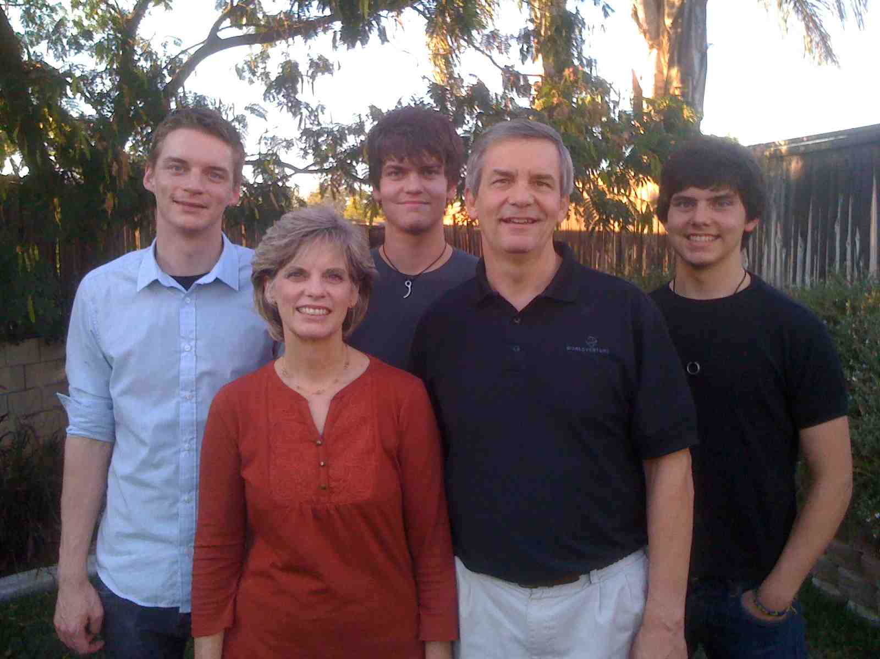
My Three Sons

Slide 62
Black

Slide 63
B. God gave us His Spirit to teach us spiritual truth (2:12-13 NLT)
12 And God has actually given us his Spirit (not the world's spirit) so we can know the wonderful things God has freely given us. ¹³When we tell you this, we do not use words of human wisdom. We speak words given to us by the Spirit, using the Spirit's words to explain spiritual truths.

Slide 64

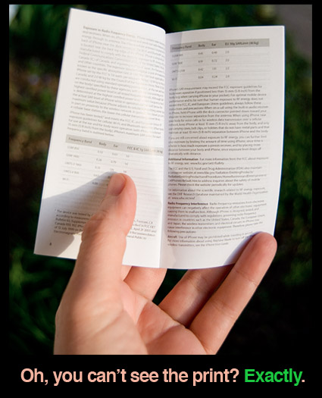
Gadget Instructions

Slide 65


"We Preach Christ Crucified"

Slide 66
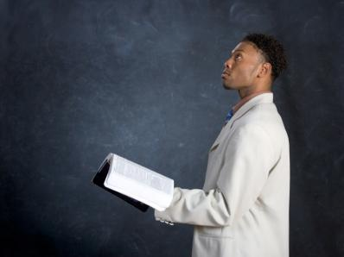
C. Unbelievers don't understand God's wisdom while Christians do (2:14-16).

Slide 67
A non-Christian thinks spiritual truth is foolish since he doesn't have the Spirit teaching him (2:14 NLT)
14 But people who aren't Christians can't understand these truths from God's Spirit. It all sounds foolish to them because only those who have the Spirit can understand what the Spirit means.

Slide 68
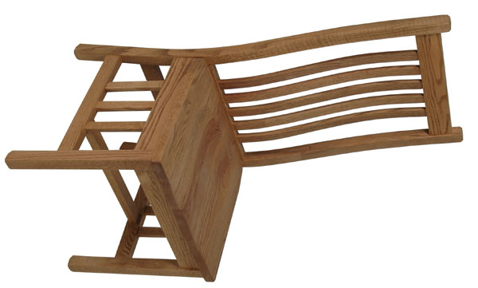
Who sits in your chair?

Slide 69


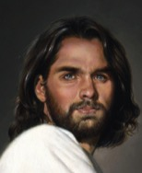
Types of People
?
?
Self
?
"Man without the Spirit"
(Non-Christian)
2:14

Slide 70
We can make intelligent spiritual decisions since Christ instructs us (1 Cor. 2:15 NLT)
15 We who have the Spirit understand these things, but others can't understand us at all.

Slide 71
Types of People
?
?
Self
?
Self
"Man without the Spirit"
(Non-Christian)
2:14
"The Spiritual Man"
(Christian)
2:15

Slide 72

Wisdom Challenge
WISDOM CHALLENGE

Slide 73
We can't teach God but He can teach us (2:16 NLT)
16 How could they? For, "Who can know what the Lord is thinking? Who can give him counsel?" But we can understand these things, for we have the mind of Christ.

Slide 74

The Focal Point of the Text
We can be truly united as a church by focusing on
God's wisdom

Slide 75

What does God's wisdom look like?
Unity
Humility
Witnessing
Character
Bible

Slide 76

We need God's wisdom

Slide 77
Black

Slide 78


NT Preaching link at BibleStudyDownloads.org
Get this presentation and script for free!
Notes:
NT Preaching (np)

